Slide 1
Software Engineering
Prepared by Bal Krishna Subedi
St. Xavier’s College

Slide 2






Slide 3






Slide 4





Slide 5
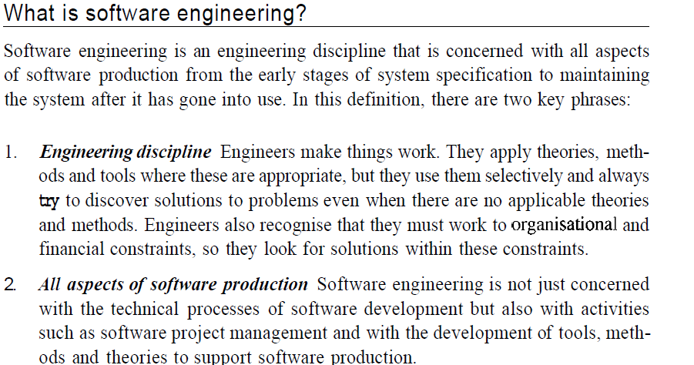

Slide 6
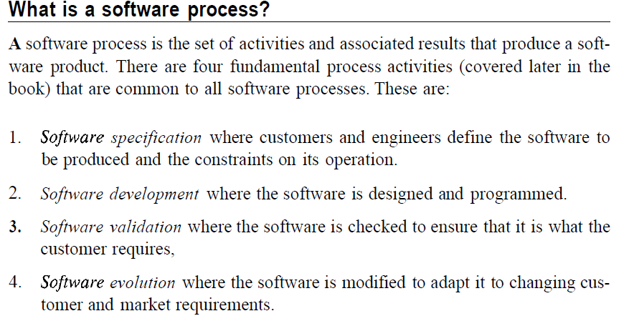

Slide 7

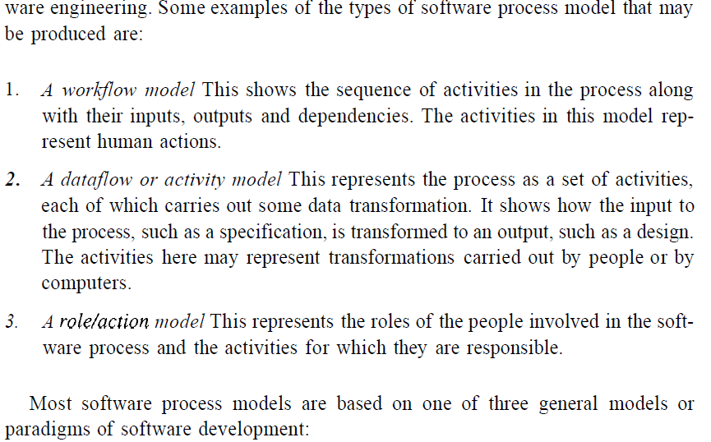

Slide 8
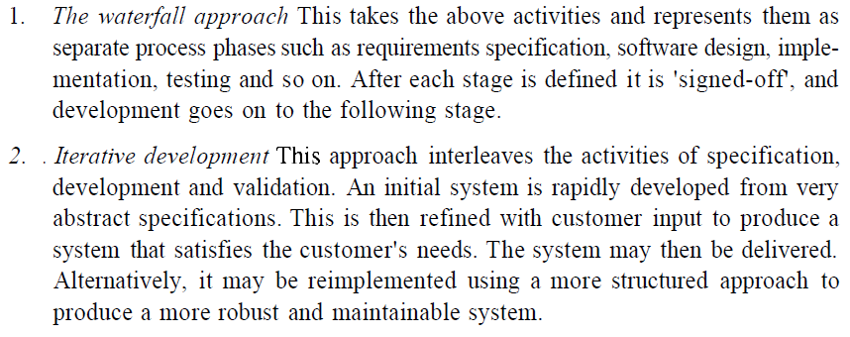

Slide 9

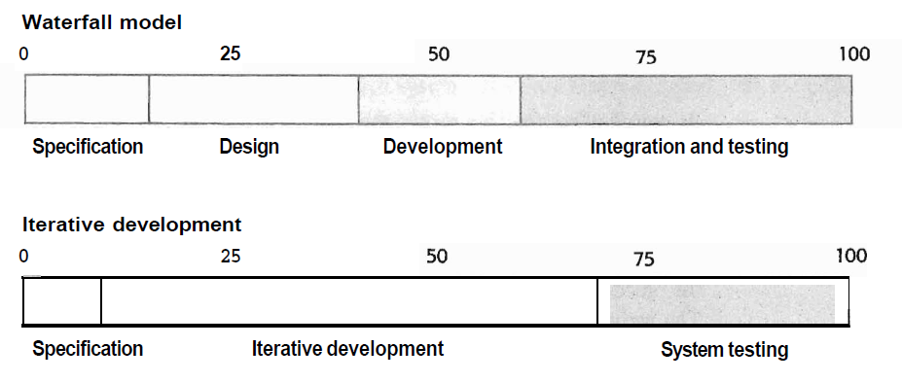

Slide 10
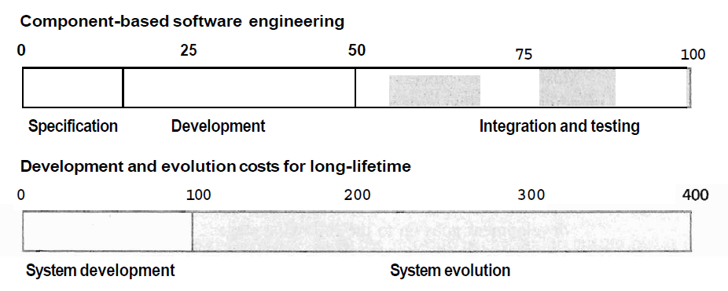

Slide 11
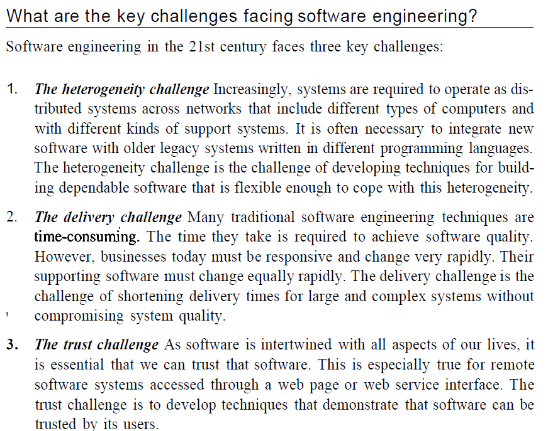

Slide 12
Thanks You
Any Query??

